Slide 1

Major Project Presentation semester-7 (mid)
Presented by:
Pritam Sarkar (171210044)
Subham Musale (171210050)
Supervisor:
Dr Rishav Singh

Slide 2
PROJECT TITLE
CLASSIFICATION OF EEG INTO NORMAL AND ABNORMAL

Slide 3
PROBLEM STATEMENT
Brain – A complex yet significant organ.
Billions of neurons forming a network and communicating via electric impulses.
EEG – A test that detects these electrical activities using metal discs.
It helps in diagnosis of brain disorders, especially epilepsy or seizures.
A session of about 20 to 30 minutes.
Interpretation of EEG records with the video footage.
A delay or lag in diagnosis of more sessions.

Slide 4
PREVIOUS RESEARCH WORK
Automated identification of abnormal adult EEGs by S. López ; G. Suarez ; D. Jungreis ; I. Obeid ; J. Picone. KNN and Random Forest ensemble achieving 41.8% and 31.7% error rate.
A deep convolutional neural network model for automated identification of abnormal EEG signals by Özal Yıldırım, Ulas Baran Baloglu & U. Rajendra Acharya 1-d CNN model achieving 20.66% error rate
AUTOMATED INTERPRETATION OF ABNORMAL ADULT ELECTROENCEPHALOGRAMS by Silvia López de Diego KNN and RF and CNN-MLP achieving 21.66 error rate.

Slide 5
OVERVIEW OF OUR PROJECT
Data Pre-processing
Feature Extraction
Build and Train Model
Evaluate

Slide 6
DATA PRE-PROCESSING
DATASET that we used is TUH EEG Abnormal Corpus that is obtained from Temple University Hospital.
Dataset Distribution
Description | Normal | Abnormal | Total
Evaluation Data | 150 | 126 | 276
Training Data | 1371 | 1346 | 2717
Total | 1521 | 1472 | 2993

Slide 7
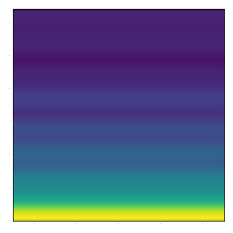
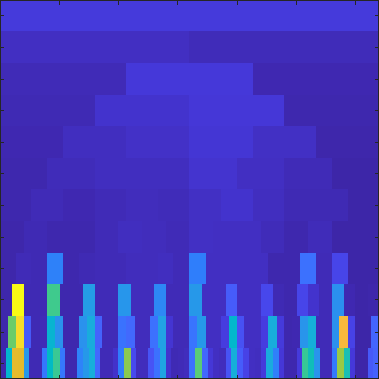
PRE-PROCESSING TECHNIQUES
Spectrogram: A spectrum of frequencies of signal varying with time. We converted the EEG signal from waveform to time series spectrum.
Kurtogram: It is a fourth order spectral analysis tool.
Spectrogram of a data point
Kurtogram

Slide 8
DATA PRE-PROCESSING WALKTHROUGH
Dataset in EDF format (European Data Format)
pyedflib in python and scipy.io library used to extract the data.
First we used all the signals. Then we used the top 21 signals.
Conversion in MATLAB.

Slide 9
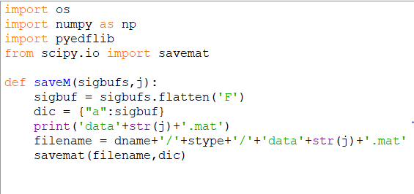
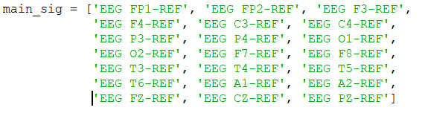
Fig-2
Fig-1

Slide 10
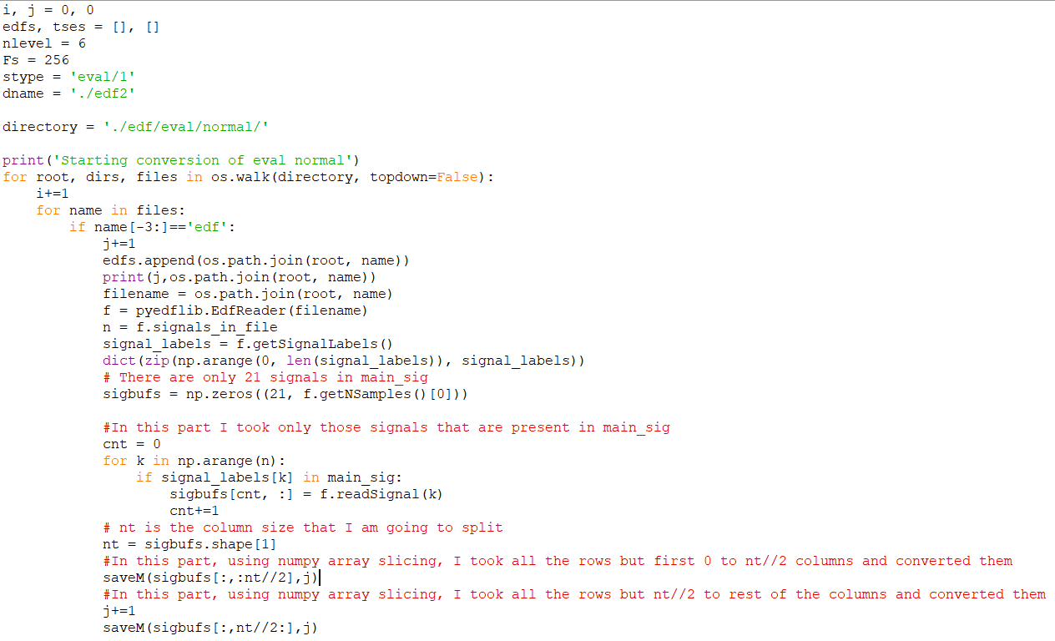
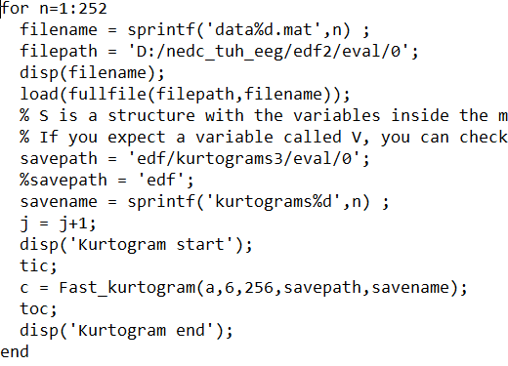
MATLAB Script
Python Script

Slide 11
FEATURE EXTRACTION
For the feature extraction we used VGG-19 pretrained model.
Took output from “block4_conv1” layer and used as our Feature vector for our classifier model.

Slide 12
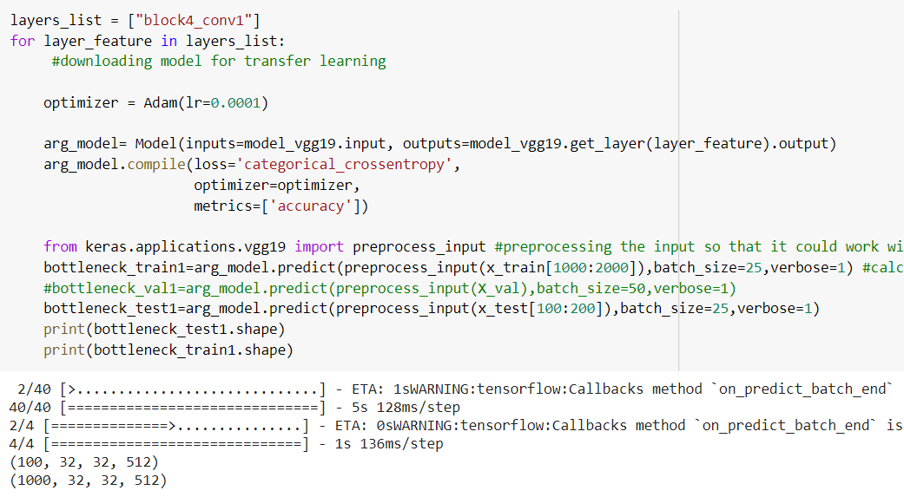

Slide 13
BUILD AND RUN MODEL
We build our random-forest ensemble classifier using sklearn library.
Then we trained it using our feature vector and got the output.

Slide 14
